Slide 2
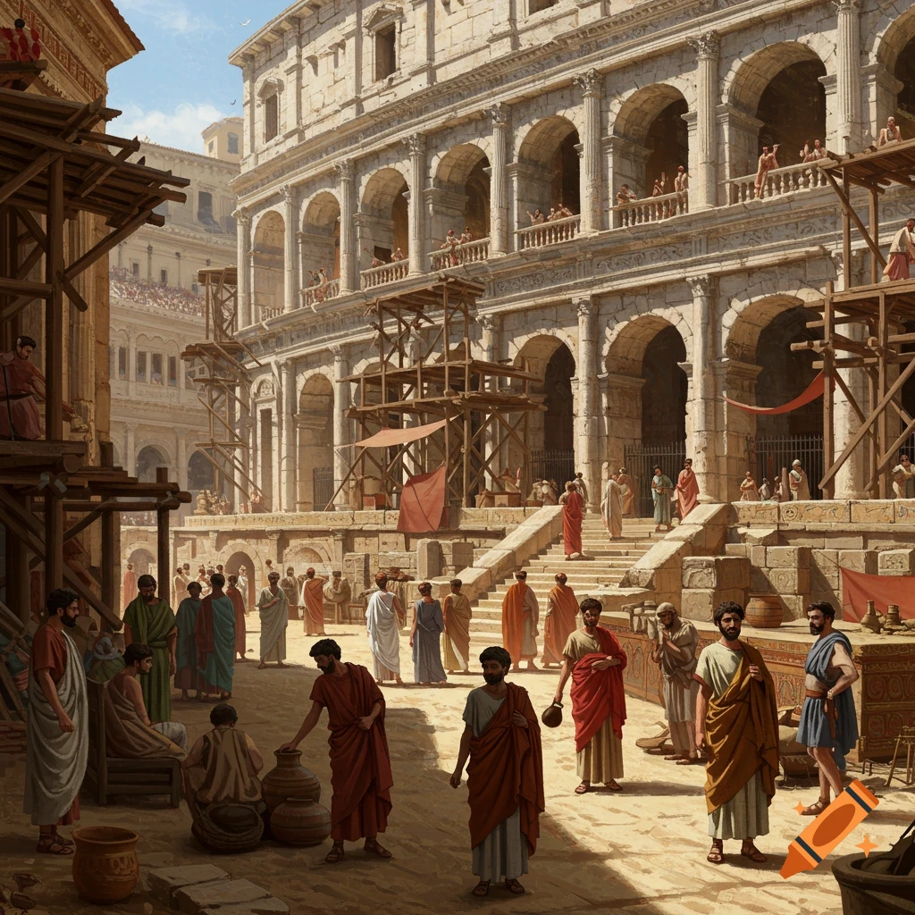
Ancient Churches in Modern Times
Thessalonica

Slide 3
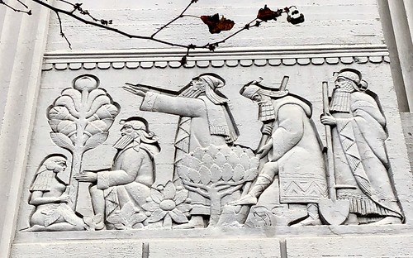
How to view the church
A correct view of true teachers 1.2:1-12
A correct view The Word 2:13
A correct view of other churches 1:6-9, 2:14

Slide 4
How to View Culture
A correct view of work 1.4.11-12, 2.3:7-12
A correct view of our bodies 1.4:1-7

Slide 5
How to view eternity
Kingdom first 1.1:7-8
Life after death 1:10, 2:19-20, 3:13, 4:13-18, 5:1-11, 5:23-24, 2. 1:5-10, 2:2ff.
The wrongs will be righted

Slide 6
How to view eternity
1 Thessalonians 5:23-24 Now may the God of peace Himself sanctify you completely; and may your whole spirit, soul, and body be preserved blameless at the coming of our Lord Jesus Christ. He who calls you is faithful, who also will do it.

